Slide 1


Big Data & IPO Preparation

Slide 2


Today's agenda
Project recap
Problem
The Analytics team
Process
Insights
Summary

Slide 3

Social Buzz is a fast growing technology unicorn that need to adapt quickly to it’s global scale. Accenture has begun a 3 month POC focussing on these tasks:
Project Recap
An Audit of their big data practice
Recommendations for a successful IPO
Analysis to find Social Buzz’s top 5 most popular categories of content.

Slide 4

Problem
Over 100000 posts per day
36, 500, 000 piece of content per year
But how capitalize on it when there is so much?
Analysis to find Social Buzz’s top 5 most popular categories of content

Slide 5



1. Andrew Fleming
Role: Chief Technical Analyst
2. Marcus Rompton
Role: Senior Principle
3. Akshat Raj
Role: Data Analyst

Slide 6
Process
1
Data Understanding
2
Data Cleaning
3
Data Modelling
4
Data Analysis
5
Data Model

Slide 7

Insights
16
1897
MAY
UNIQUE CATEGORIES
REACTIONS TO “ANIMAL” POST
MONTH WITH MOST POSTS

Slide 8
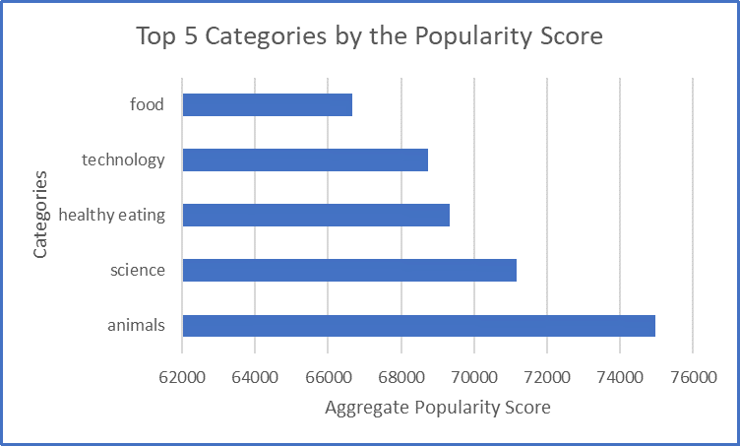

Slide 9
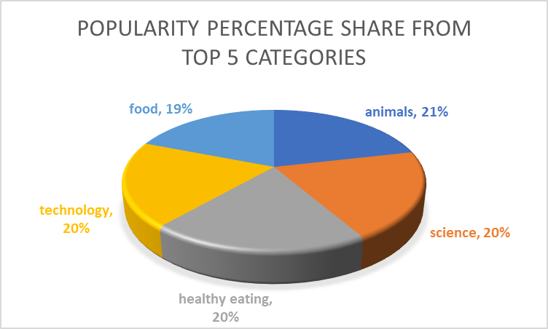

Slide 10

Analysis
Analysis and Science are the two most popular categories of content , showing that people enjoy “real-life” and “factual” content the most.
INSIGHT
Summary
Food is a common theme with the top 5 categories with “Healthy Eating” ranking the highest. This may give an indication to the audience within your user base. You could use this insight to create a campaign and work with healthy eating brands to boost user engagement
This ad-hoc analysis is very insightful, but it’s time to take this analysis into large scale production for real-time understanding of your business.

Slide 11
Thank you!
ANY QUESTIONS?

